Slide 1
Introduction to High-Level Synthesis with Vivado HLS

Slide 2
Objectives
After completing this module, you will be able to:
Describe the high level synthesis flow
Understand the control and datapath extraction
Describe scheduling and binding phases of the HLS flow
List directives set by Vivado HLS
List comprehensive language support in Vivado HLS
Identify steps involved in validation and verification flows

Slide 3
Introduction
The Xilinx® Vivado® High-Level Synthesis (HLS) tool transforms a C specification into a register transfer level (RTL) implementation that you can synthesize into a Xilinx field programmable gate array (FPGA).
You can write C specifications in C, C++, or SystemC, and the FPGA provides a massively parallel architecture with benefits in performance, cost, and power over traditional processors.

Slide 4
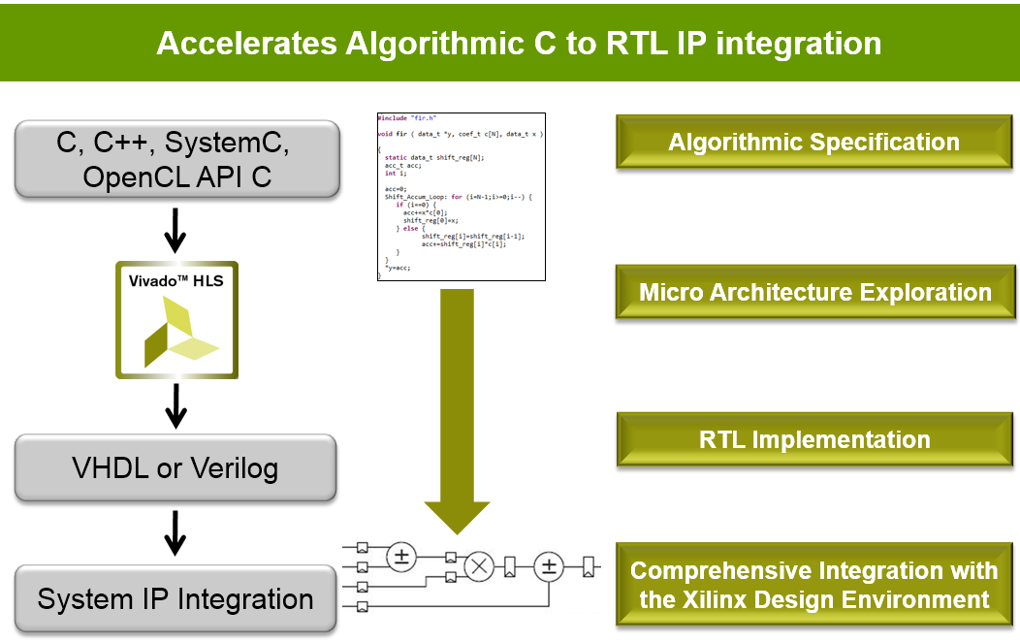
High-Level Synthesis: HLS
High-Level Synthesis
-Creates an RTL implementation from C, C++, System C, OpenCL API C kernel code
-Extracts control and dataflow from the source code
-Implements the design based on defaults and user applied directives
Many implementation are possible from the same source description
-Smaller designs, faster designs, optimal designs
-Enables design exploration

Slide 5
Need for High-Level Synthesis
Algorithmic-based approaches are getting popular due to accelerated design time and time to market (TTM)
Larger designs pose challenges in design and verification of hardware at HDL level
Industry trend is moving towards hardware acceleration to enhance performance and productivity
CPU-intensive tasks can be offloaded to hardware accelerator in FPGA
Hardware accelerators require a lot of time to understand and design
Vivado HLS tool converts algorithmic description written in C-based design flow into hardware description (RTL)
Elevates the abstraction level from RTL to algorithms
High-level synthesis is essential for maintaining design productivity for large designs

Slide 6
Contd..
Synthesis is not supported for some constructs, including:
Dynamic memory allocation:
- An FPGA has a fixed set of resources, and the dynamic creation and freeing of memory resources is not supported.
Operating system (OS) operations:
- All data to and from the FPGA must be read from the input ports or written to output ports.
- OS operations, such as file read/write or OS queries like time and date, are not supported.
- Instead, the C test bench can perform these operations and pass the data into the function for synthesis as function arguments.
Many of the C++ Standard Template Libraries (STLs) contain function recursion and use dynamic memory allocation. For this reason, the STLs cannot be synthesized.

Slide 7
Download and Installation
For users wishing to install one of the full Vivado Editions, there are three choices.
Vivado Design Suite - HLx Editions:
WebPack and Editions: Web installer for windows
WebPack and Editions: Web installer for Linux
All OS Single File Download
All Editions and download options are available on the Xilinx website: www.xilinx.com

Slide 8
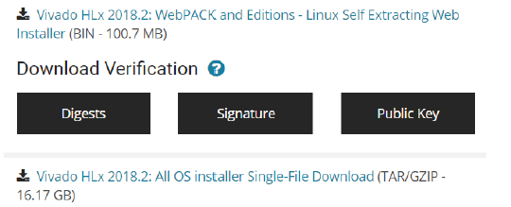
Contd..Download and Installation
To download a full Edition of the Vivado Design Suite:
Goto:
www.xilinx.com =>Support=>Downloads & Licensing
Under the Version heading, click the version of the tools you want to download
Click the link for the installer you want to download.

Slide 9
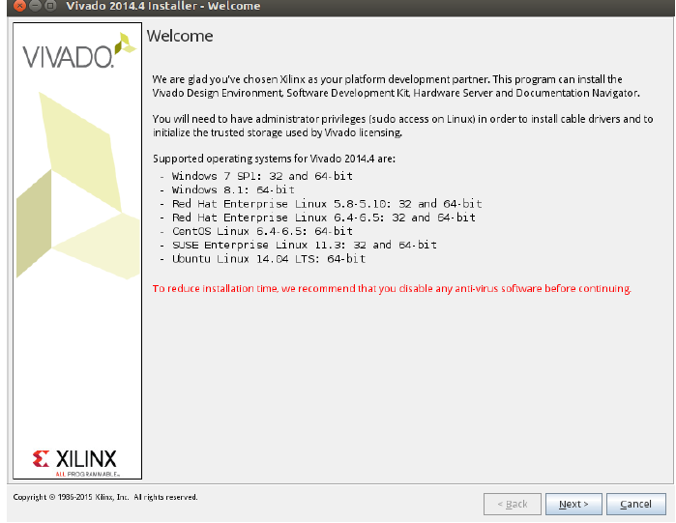
Download and Installation
.

Slide 10
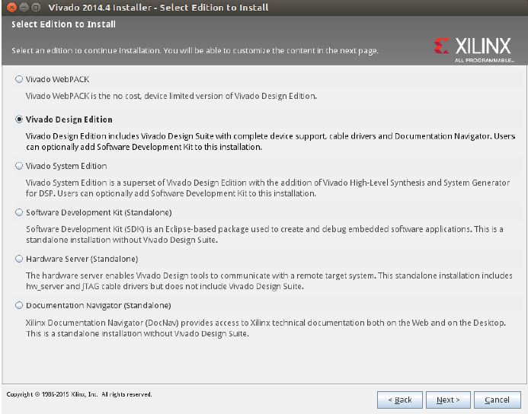
Download and Installation
.
Here select Vivado System Edition button

Slide 11
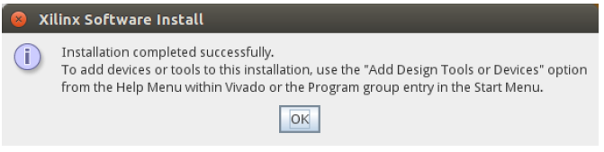
Download and Installation
.

Slide 12
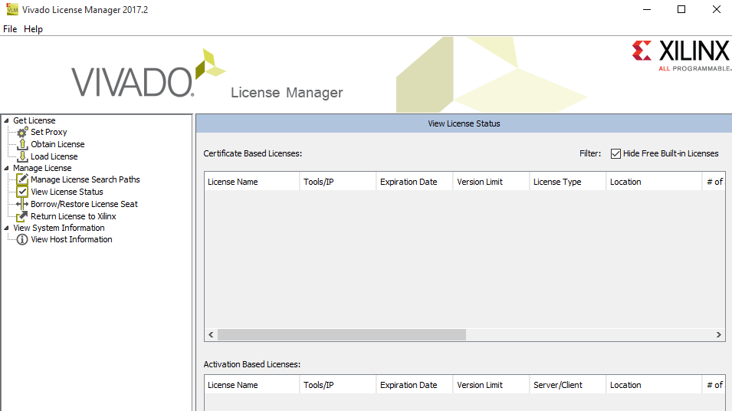
License Setup
Go to: All apps => Xilinx Design Tools => Manage Xilinx Licenses
.

Slide 13
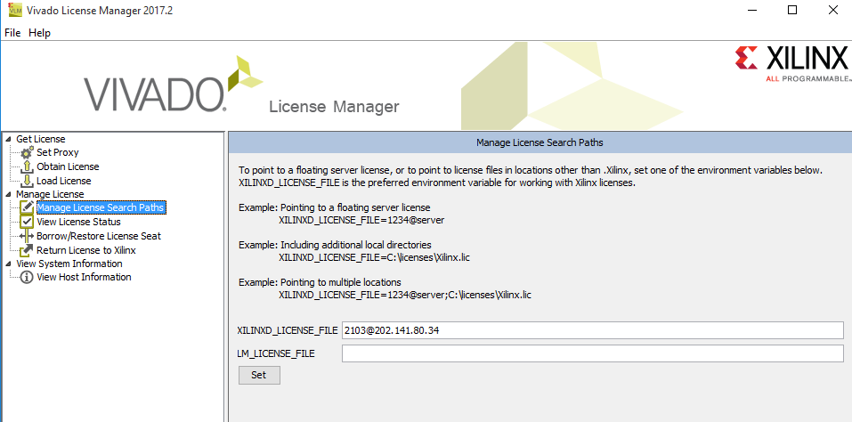
License Setup
.

Slide 14
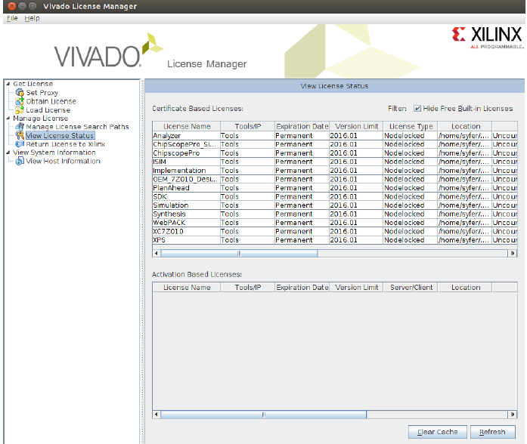
License Setup
.

Slide 15
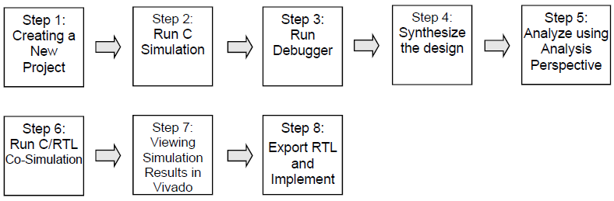
Vivado HLS Synthesis and Analysis Steps
Following are the synthesis, optimization, and analysis steps in the Vivado HLS design process:
Create a project with an initial solution.
Verify the C simulation executes without error.
Run synthesis to obtain a set of results.
Analyze the results.
After analyzing the results, you can create a new solution for the project with dierent constraints and optimization directives and synthesize the new solution.

Slide 16
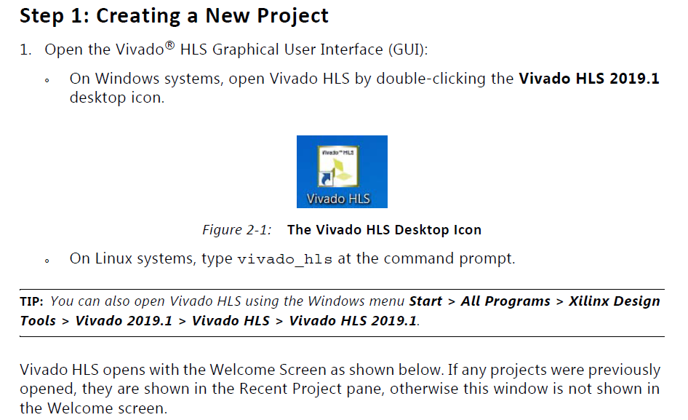
Vivado HLS Synthesis and Analysis Steps
.

Slide 17
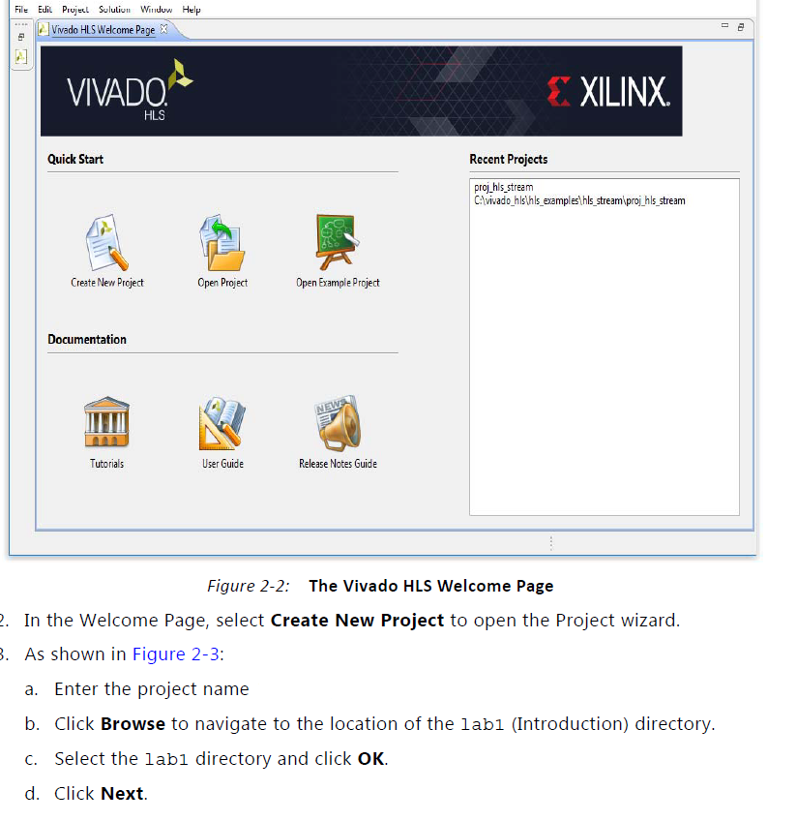
Contd..
.

Slide 18
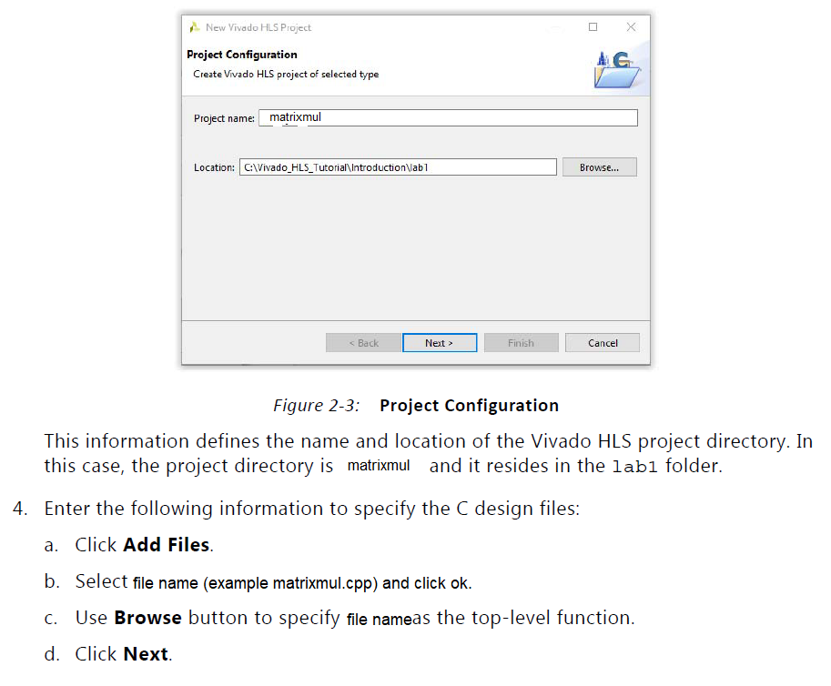
Contd..
.

Slide 19
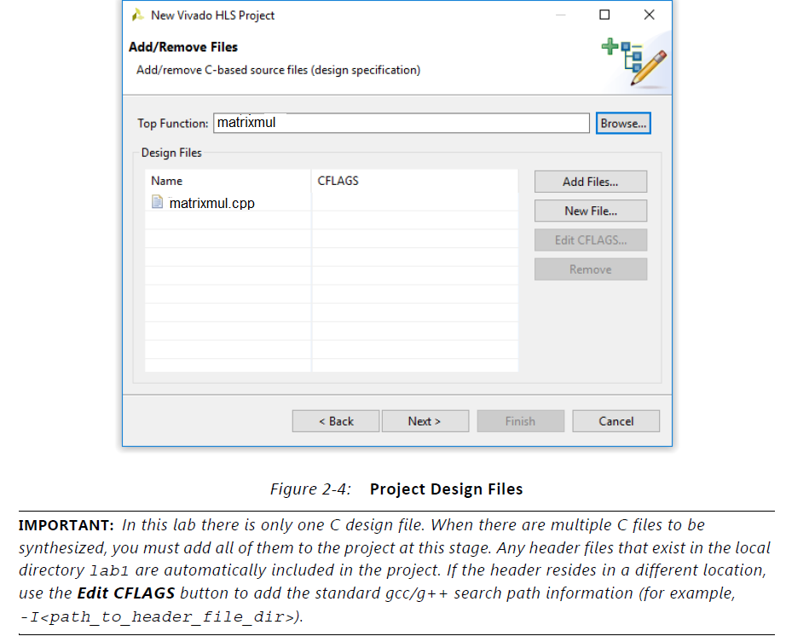
Contd..
.

Slide 20
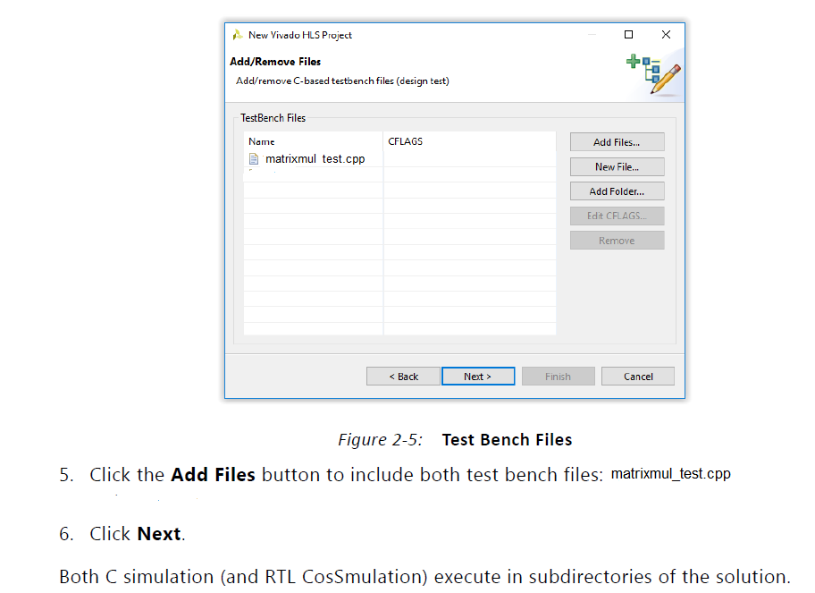
Contd..
.

Slide 21
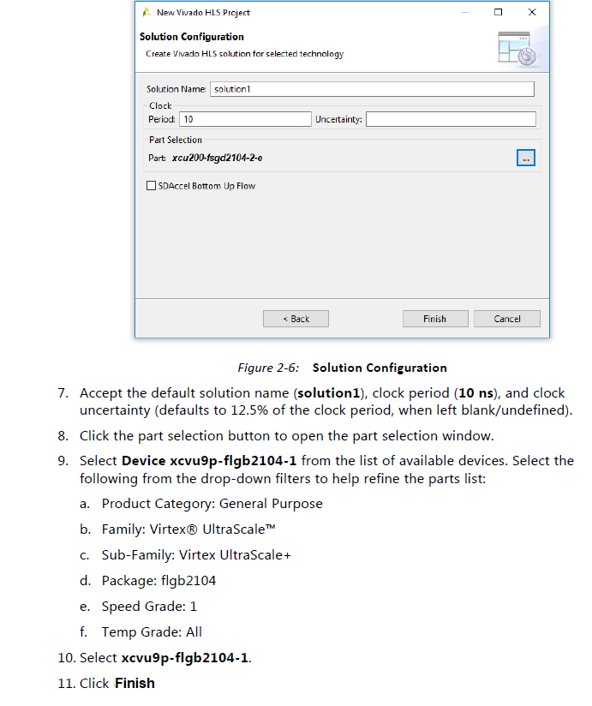
Contd..
.

Slide 22
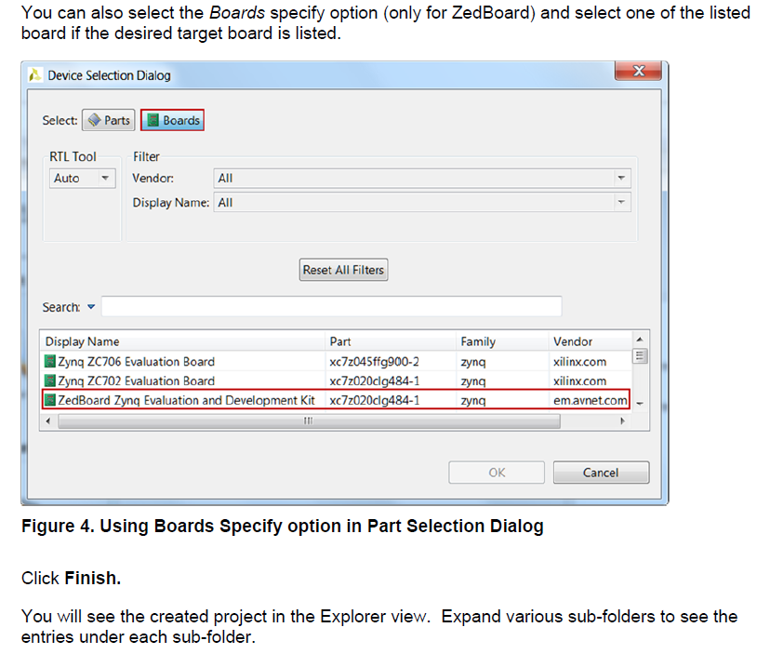
Contd..
.

Slide 23
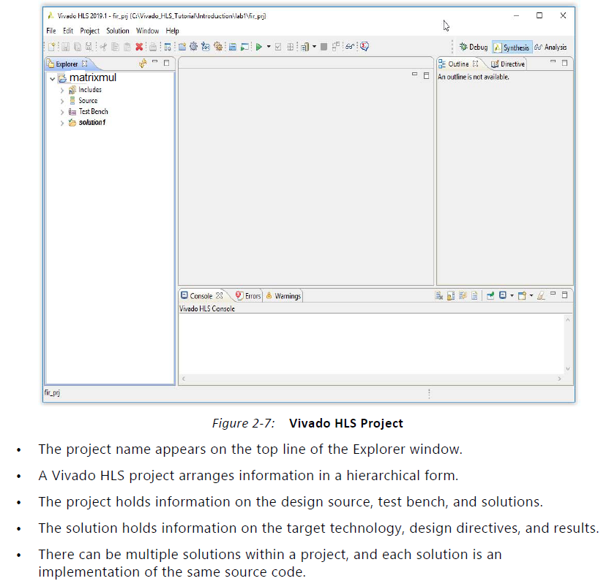
Contd..
.

Slide 24
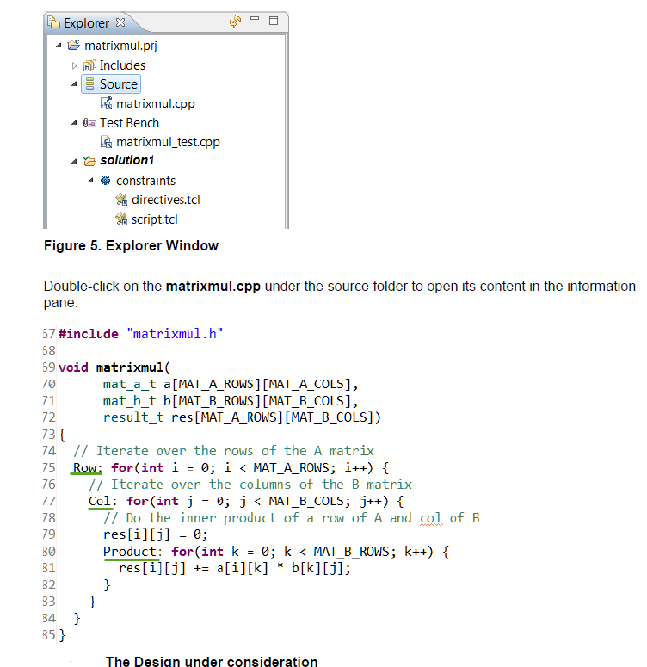
Contd..
.

Slide 25
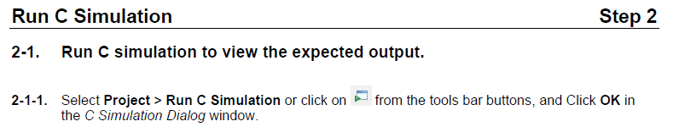
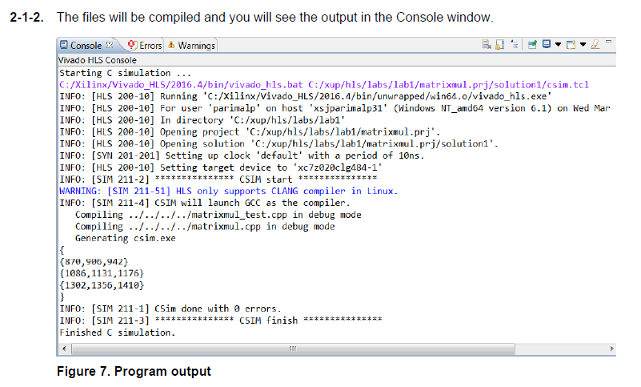
Contd..
.

Slide 26
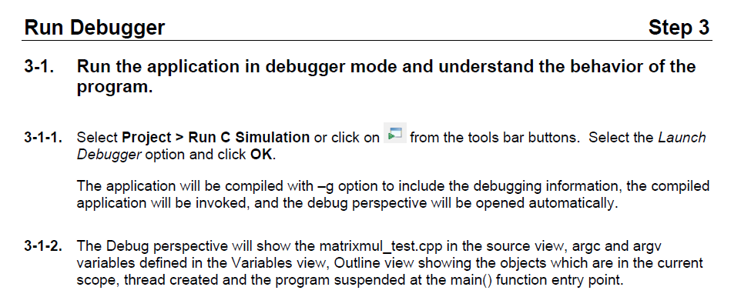
Contd..
.

Slide 27
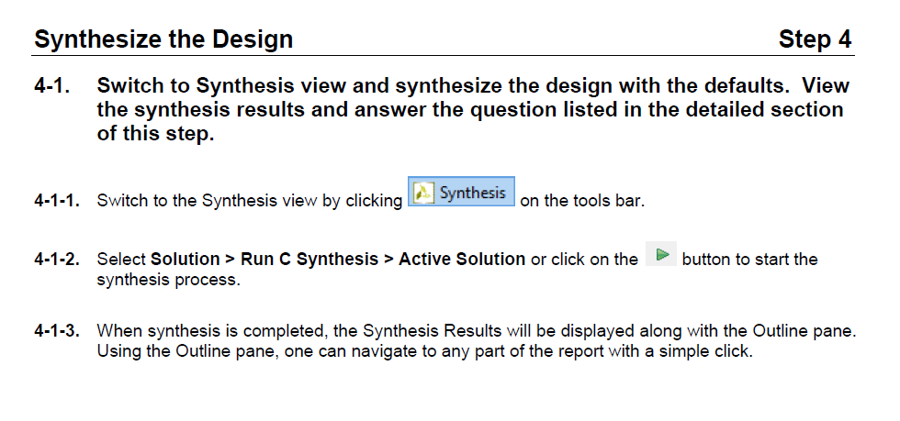
Contd..
.

Slide 28
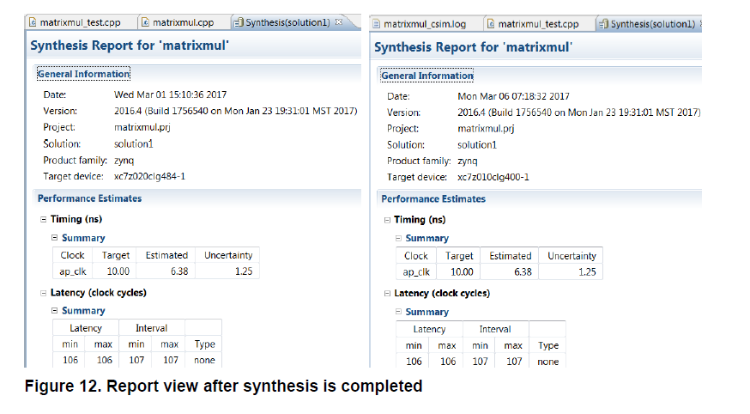
Contd..
.

Slide 29
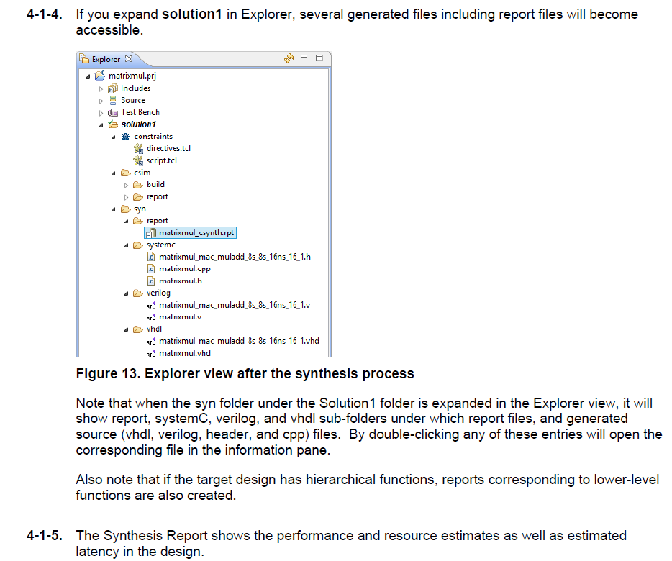
Contd..
.

Slide 30
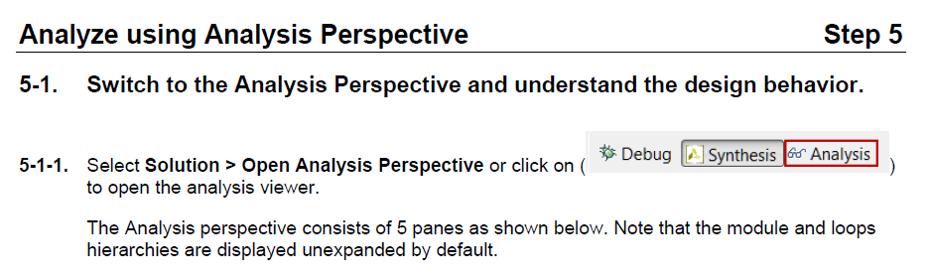
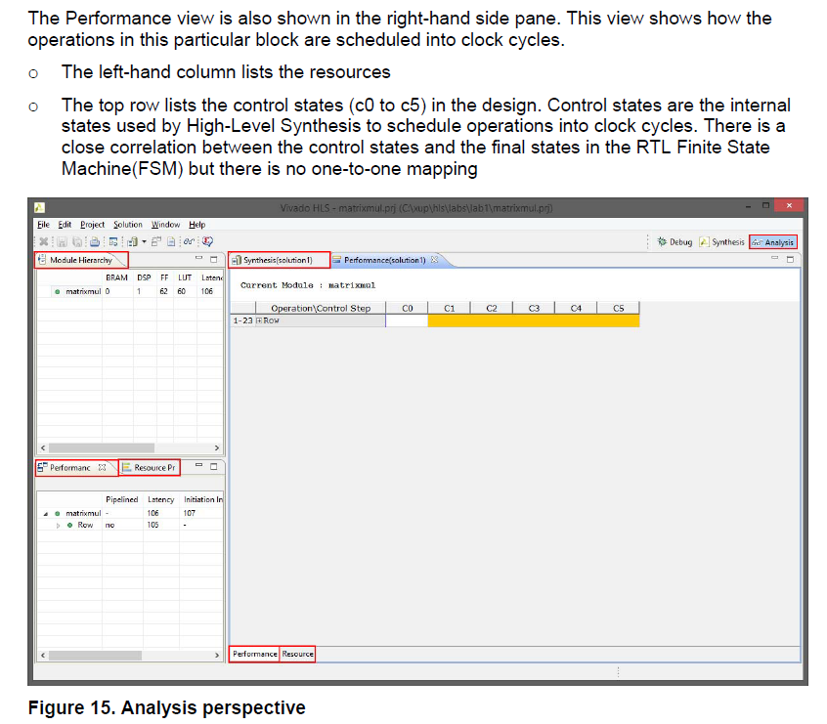
Contd..
.

Slide 31
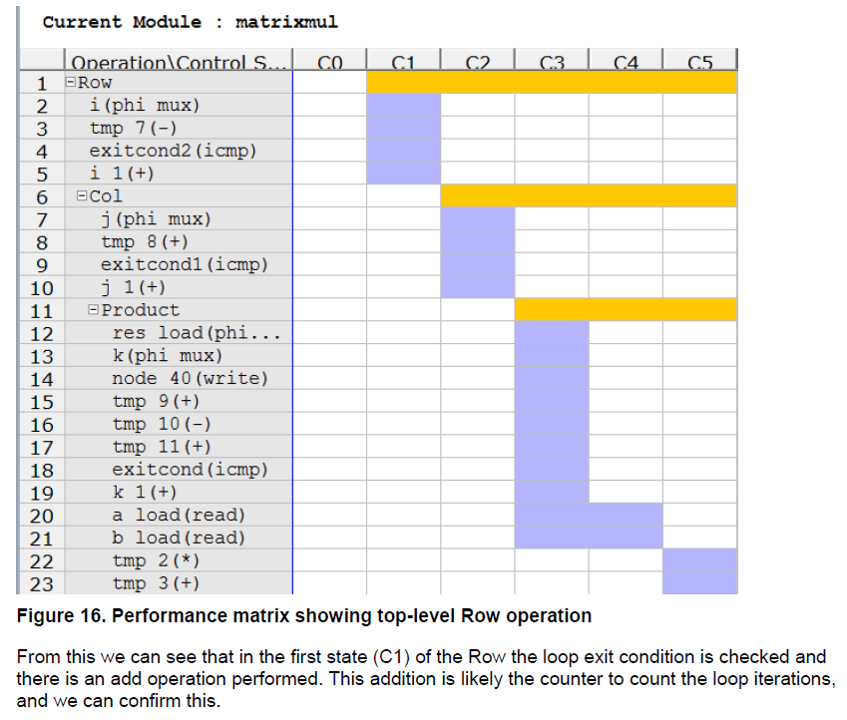
Contd..
5-1-2. Click on ‘+’ of loop Row to expand, and then similarly click on sub-loops Col and Product to fully expand the loop hierarchy.
.

Slide 32
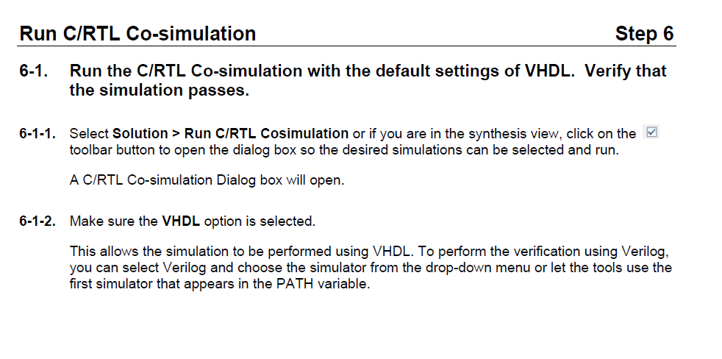
Contd..
.

Slide 33
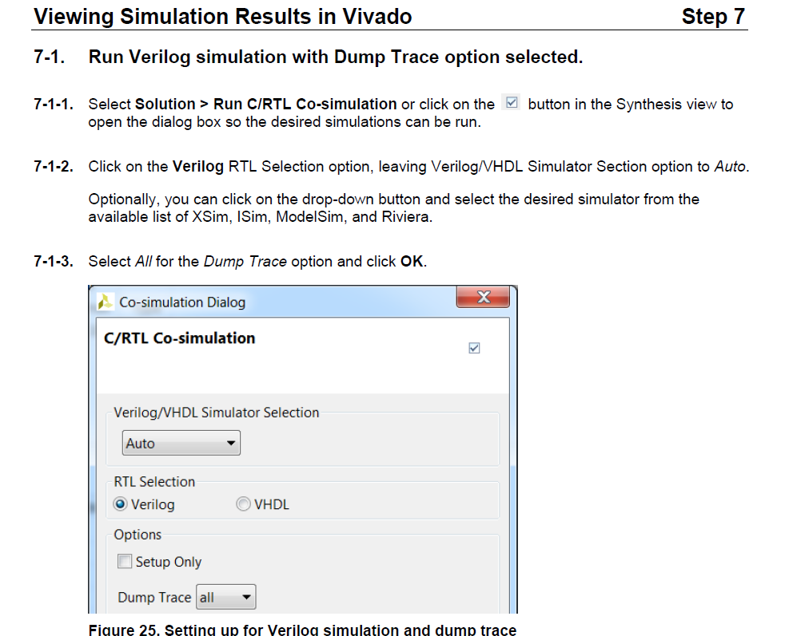
Contd..
.

Slide 34
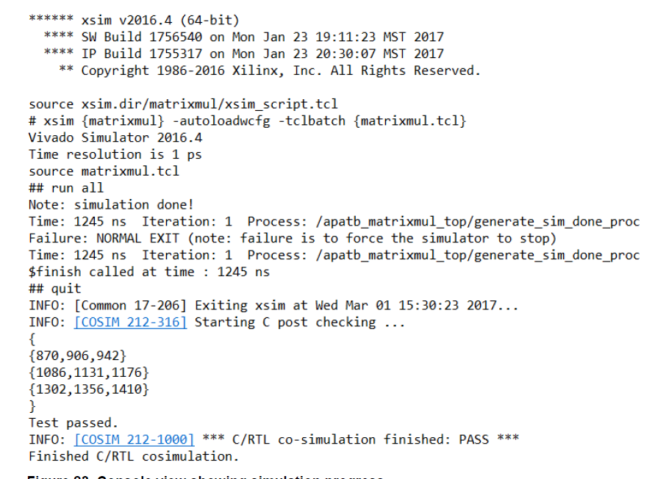
Contd..
.

Slide 35
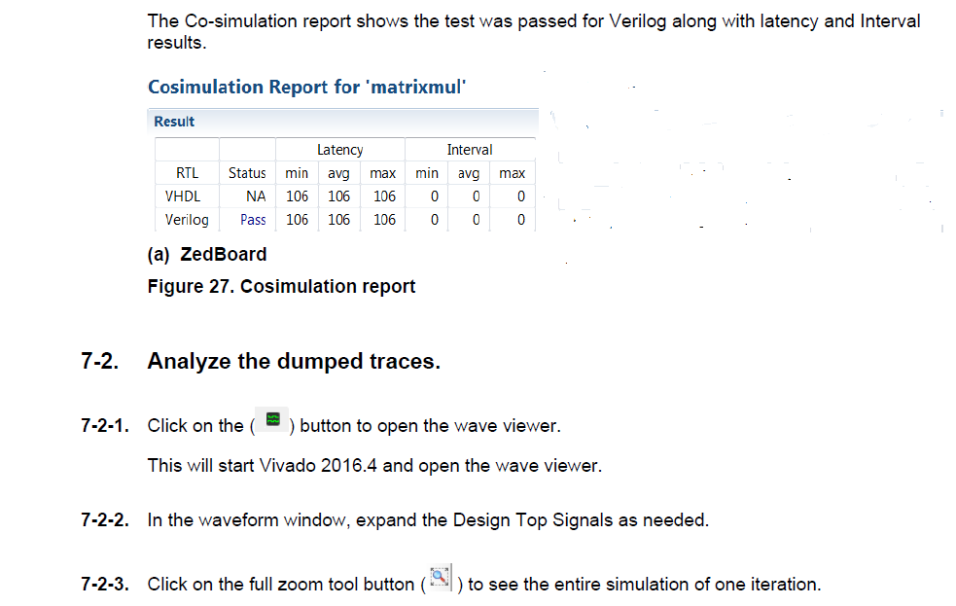
Contd..
.

Slide 36
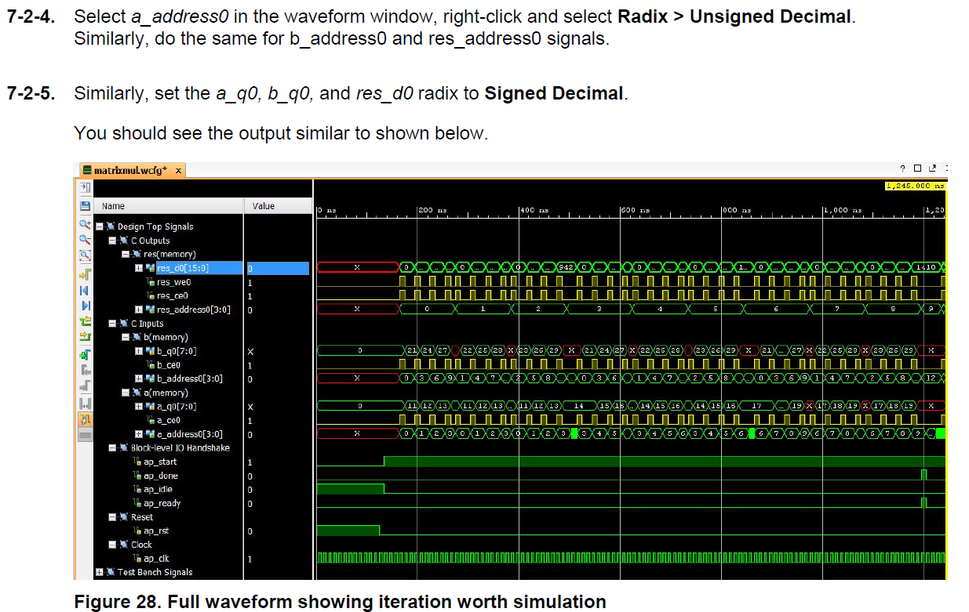
Contd..
.

Slide 37
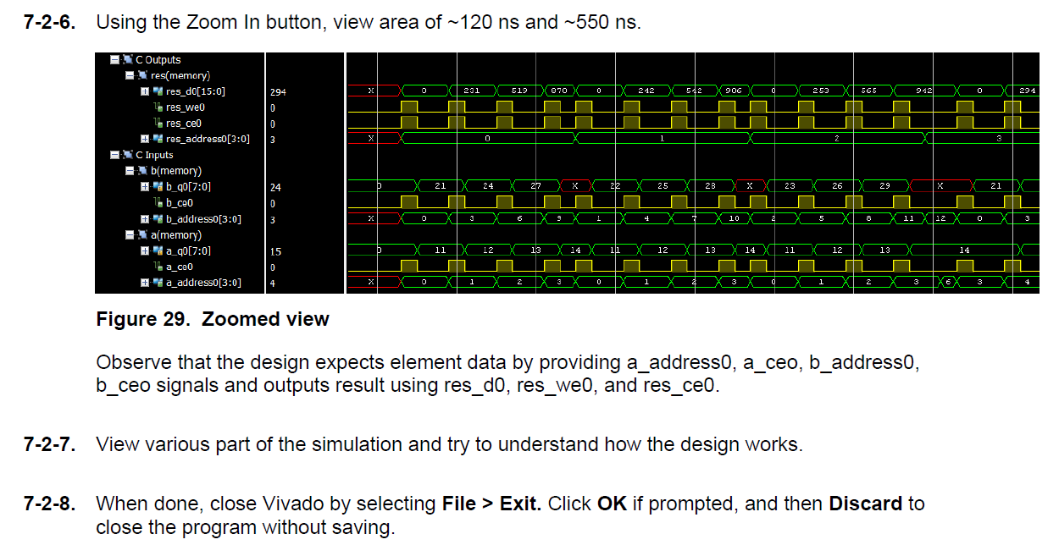
Contd..
.

